Slide 1


Predicting ESRB Ratings for Video Games
By Carl Cook

Slide 2



Game Ratings
Generally Rated E – M
Based on Content
Detailed on Game Case

Slide 3
Goals
Predict Game Ratings
Maximize Recall for M-rated Games
Minimize M-ratings Classified Below ‘T’
Identify Methods for Improvement

Slide 4
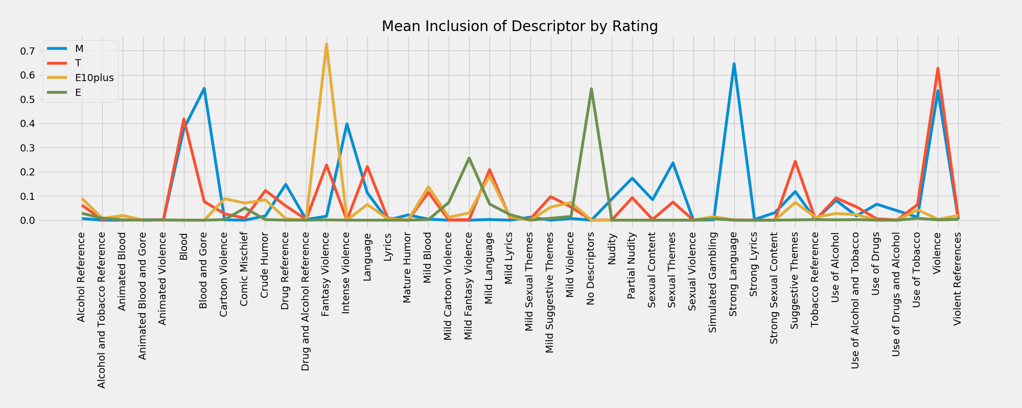
Rating Indicators
Most Indicative Descriptors:
Blood and Gore
Fantasy Violence
Intense Violence
Mild Fantasy Violence
No Descriptors
Strong Language

Slide 5
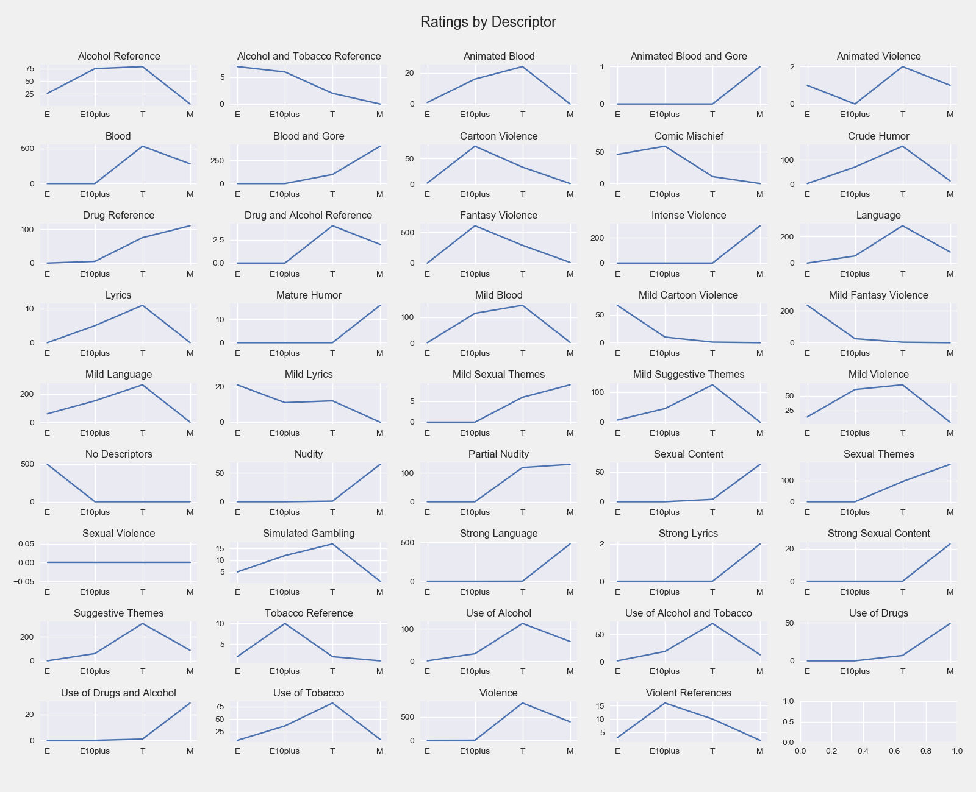

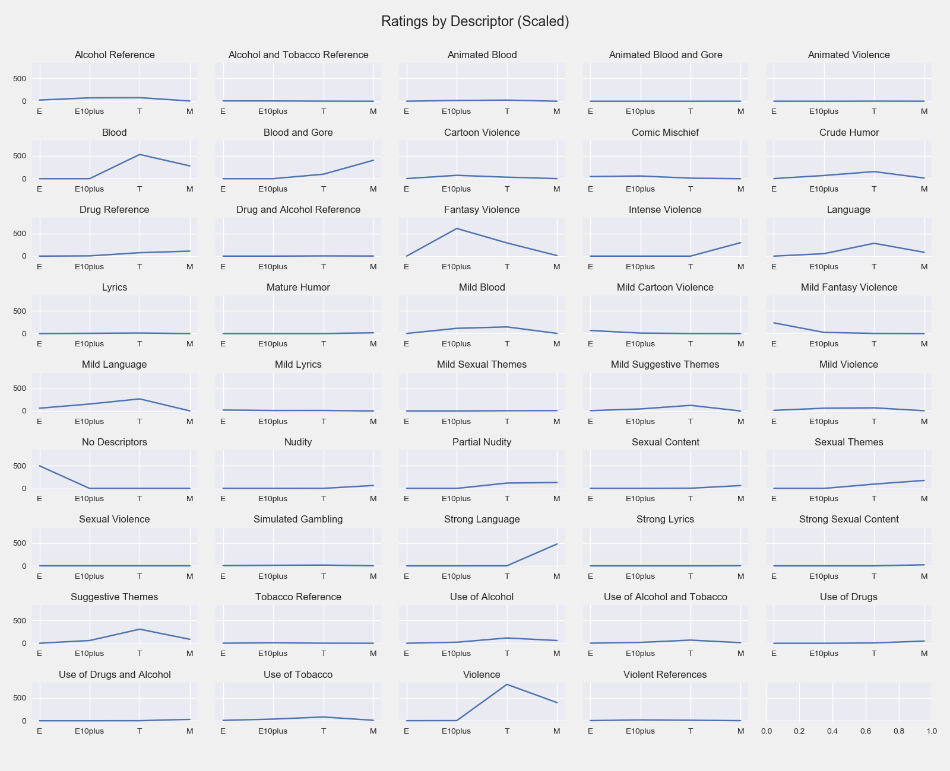
Descriptor Usage

Slide 6
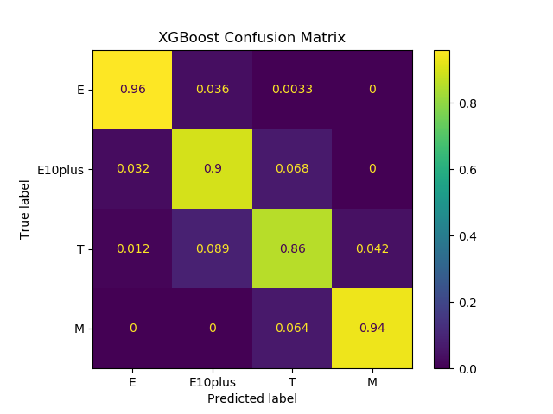
Model Predictions
XGBoost Model:
92% recall for M ratings.
Most misclassification is slight.
No E/M or M/E misclassification.

Slide 7
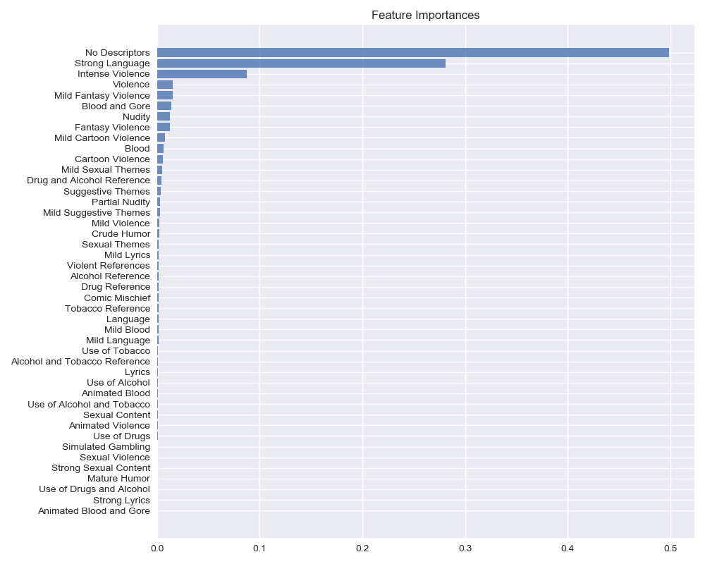
Important Features
No Descriptors
Strong Language
Intense Violence

Slide 8
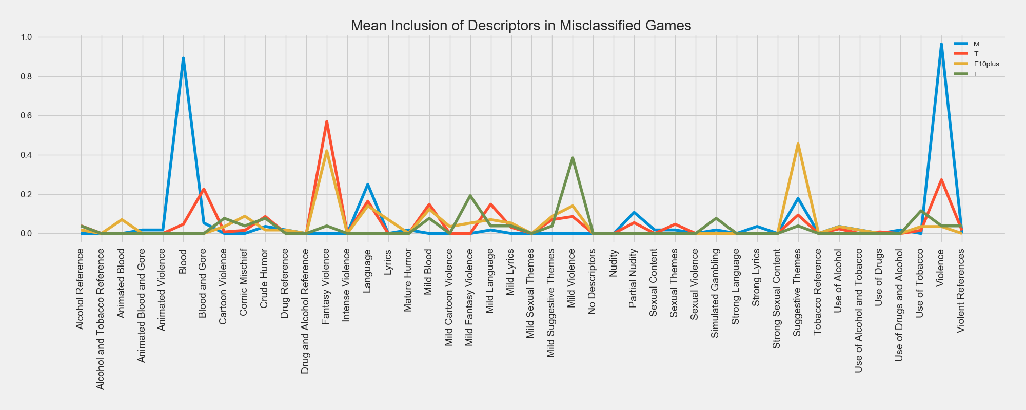
Misclassified Games
Common Descriptors :
Blood
Fantasy Violence
Mild Violence
Suggestive Themes
Violence

Slide 9
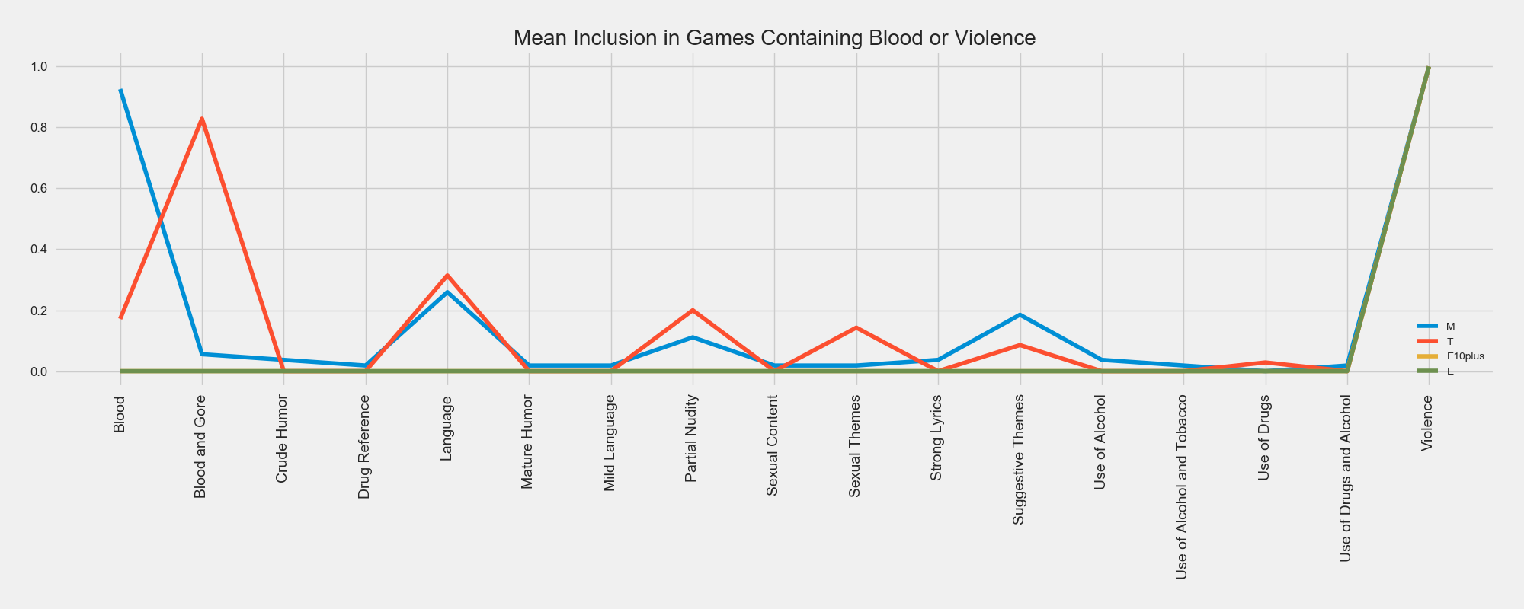
Recommendations
Consistent, Intuitive Labeling
More Descriptive Labeling

Slide 10


Future Work
Image Classification

Slide 11

Thank you for your time and attention!

